Slide 1
Introduction to Research Reproducibility and Transparency
Dr. Ben Marwick and Delaney Glass
Anthro Data Science Working Group

Slide 2
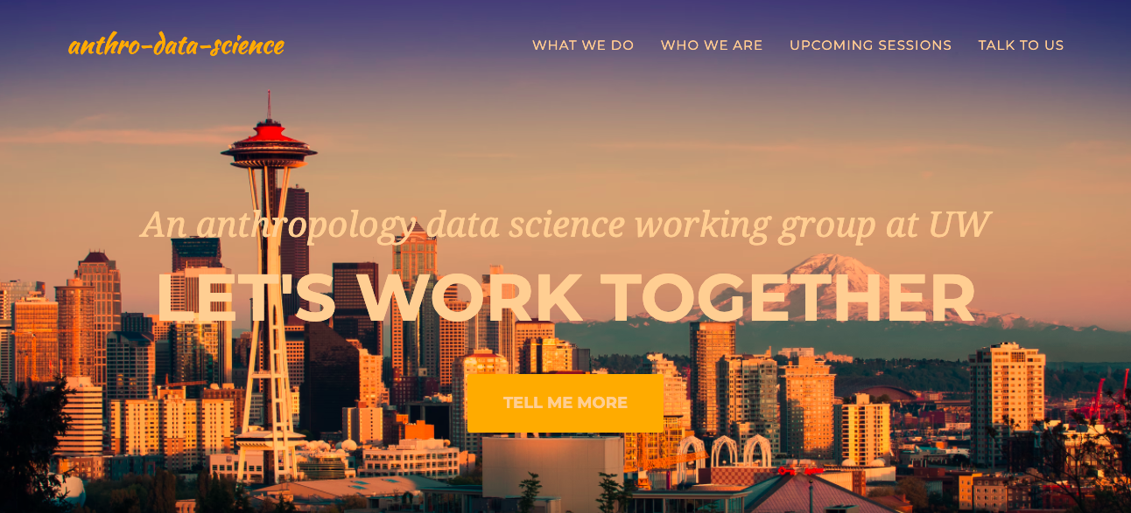
Notes:
Our website: https://anthro-data-science.github.io/
Join our low-volume mailing list (and don't forget to check spam!): https://groups.google.com/u/2/g/anthro-data-science

Slide 3
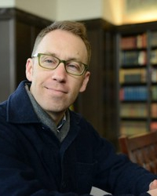
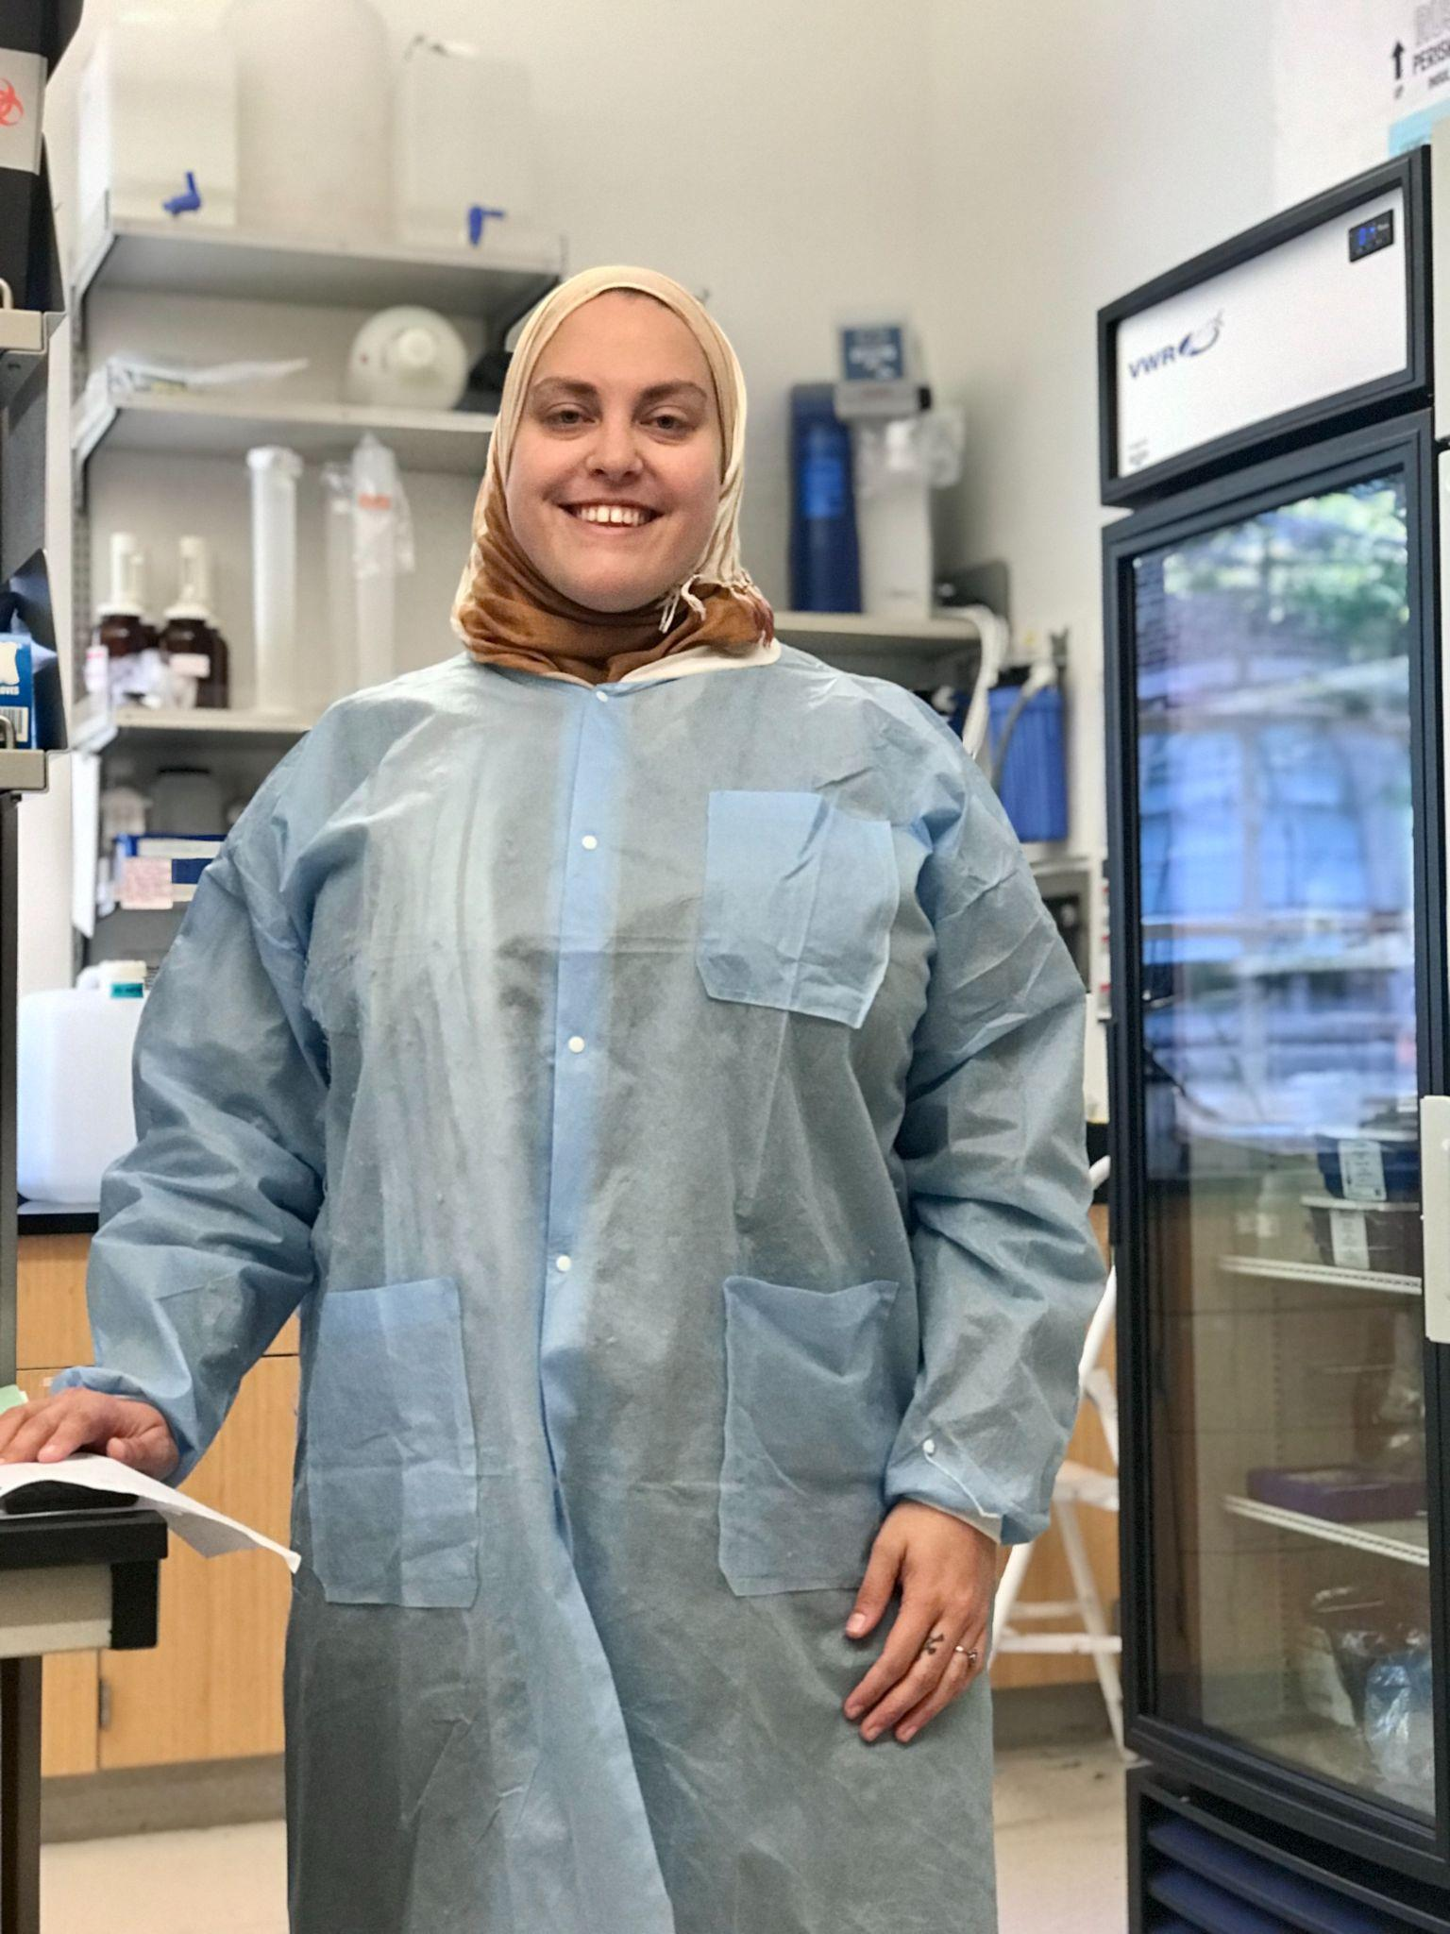
A little about Ben & Delaney
Archaeologist of S.E. Asia and Australia & professor
Open Research leader
R and coding wizard
Director of Interdisciplinary Data Science Minor
Biological Anthro PhD/ Epi MPH student
Mixed methods anthropologist
Former Data Science for Social Good Fellow
Research Advisor, Undergraduate Research Program

Slide 4
Now a little about YOU!
If you’re comfortable, please unmute or type in the chat:
Your name
Pronouns (optional)
Your department/profession/area of study
How familiar are you with research reproducibility and transparency?
What is your favorite thing right now? (e.g. food, music, activity, etc)

Slide 5
Conversation Based Workshop
Open Access
Open Methods
Open Data
5 minute break
Jamboard discussion for last 30 minutes
Supporting undergraduate researchers
Using these tools for qualitative research or fields apart from natural sciences
Other topics of interest to YOU!

Slide 6
Workshop Etiquette
Ask questions by unmuting, raising hand, or in the chat!
Engage in conversation if you’re comfortable
Respect that we are all learners
There are no perfect answers
Ethics, decision making, and perspectives will vary by field and individually
We treat each other as peers, whether you are a student, faculty, staff, professional, and regardless of title etc

Slide 7
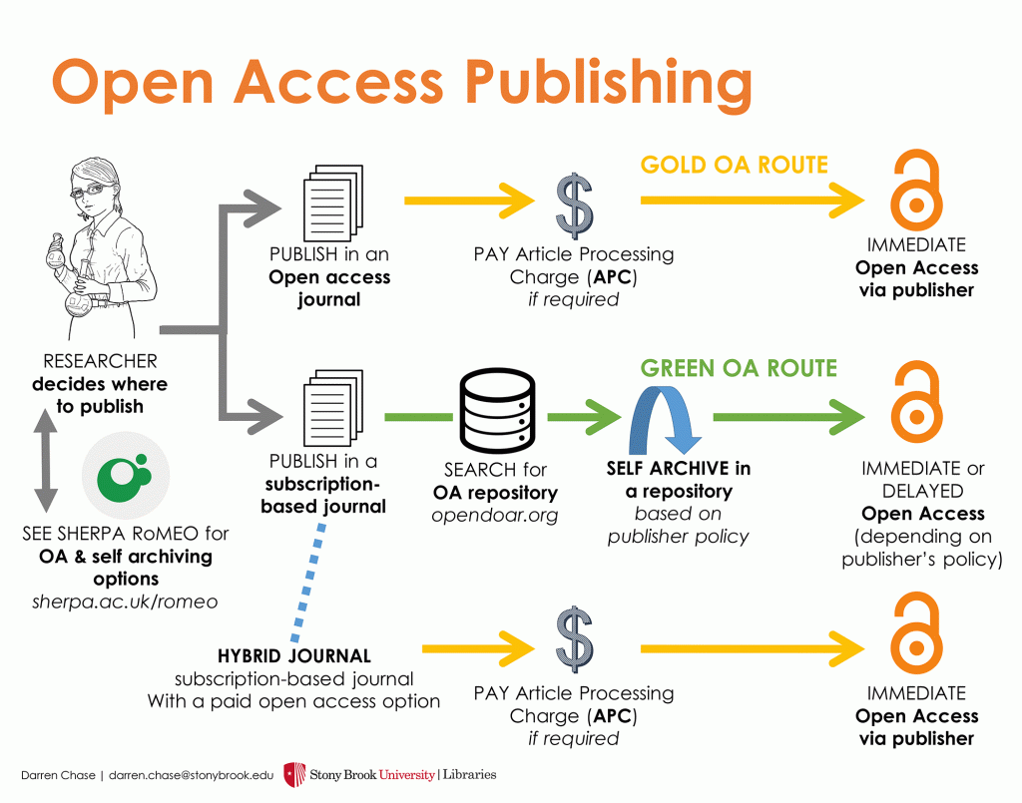



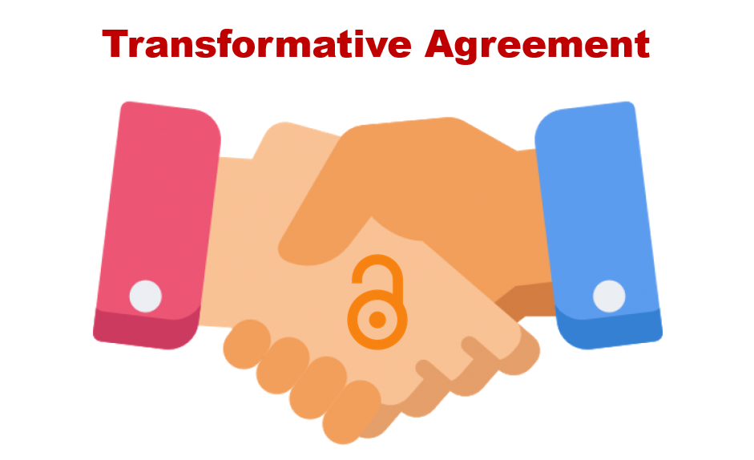
Open Access
https://shareyourpaper.org/

Slide 8
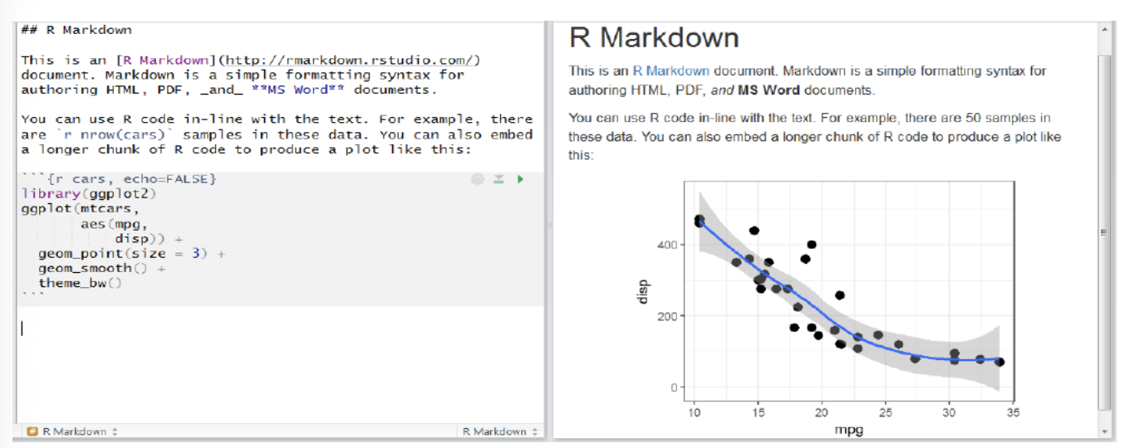

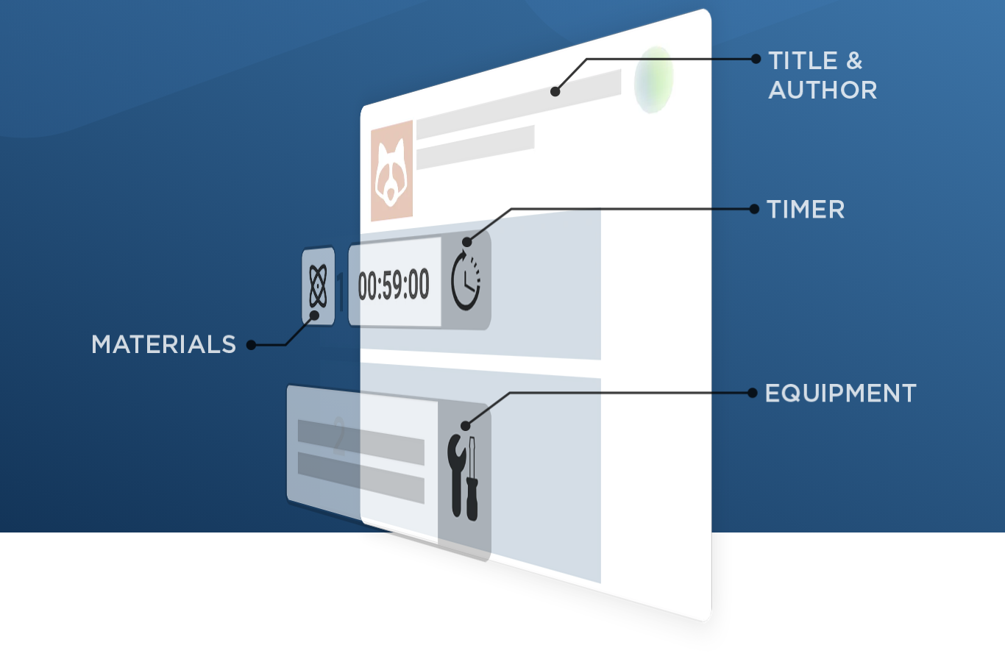

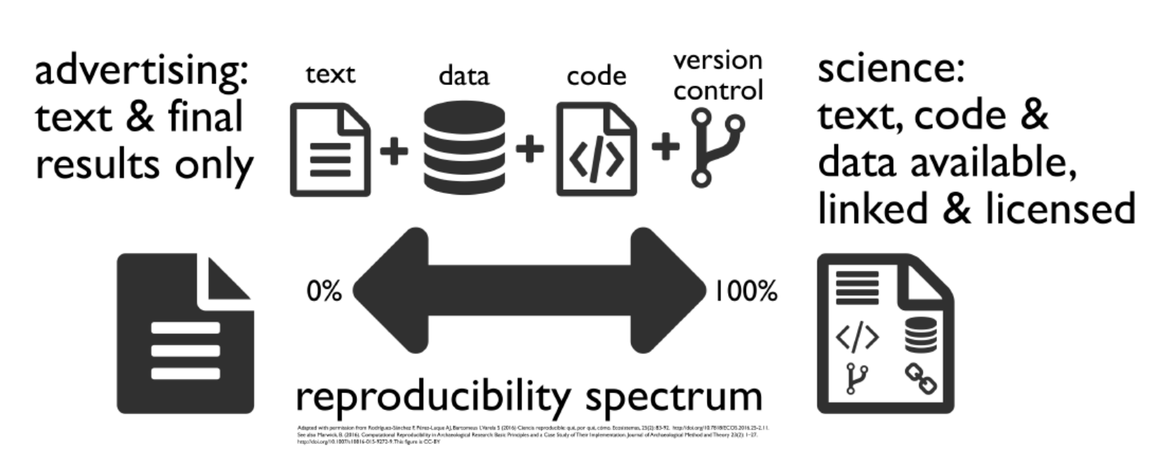
Open Methods

Slide 9
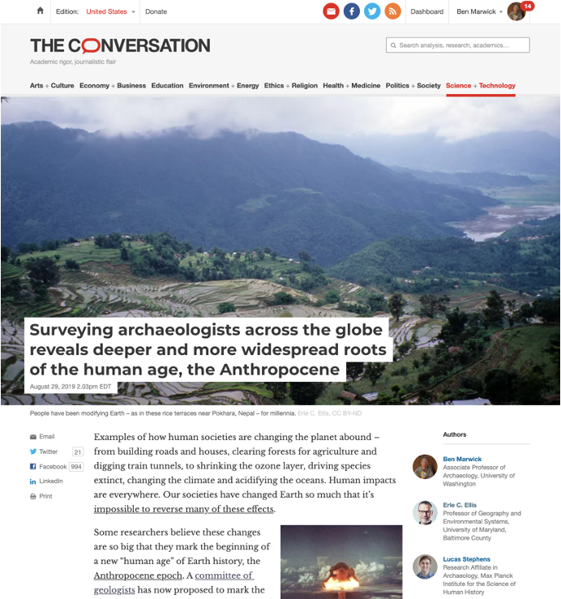
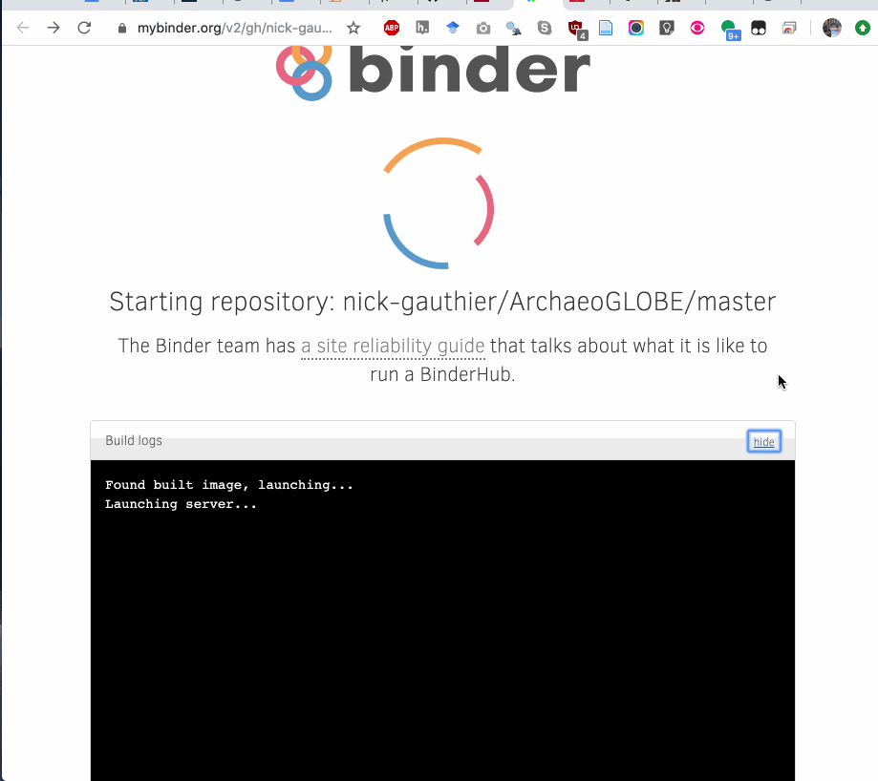
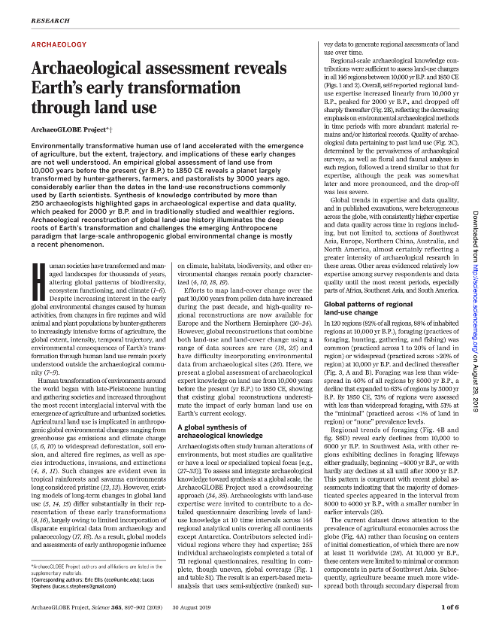
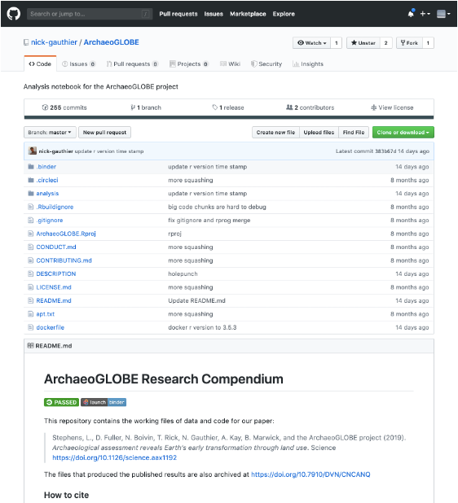
Open Methods
Stephens, L., Fuller, D., Boivin, N., Rick, T., Gauthier, N., Kay, A., Marwick, B,… Ellis, E. (2019). Archaeological assessment reveals Earth’s early transformation through land use. Science, 365(6456), 897–902. https://doi.org/10.1126/science.aax1192

Slide 10




Open Data: As open as possible, as closed as necessary
Reasons to share
Reasons not to share
Increase visibility and impact of your work
Demonstrate reproducibility of your results
Enable others to study and extend your findings
Support student learning
You don’t have permission
Personal privacy will be at risk
Sensitive locations will be at risk
Sensitive cultural information will be at risk
Good
Too lazy to contextualize appropriately
Fearful of scooping
Fearful of missed credit or attribution
Fear of irreproducible results & shame
Bad

Slide 11
Additional Open Method and Data Consideration for Qualitative Research
Conceptual replicability may be more important (a braided stream of multiple lines of evidence)
Transparency is possible
Pre-registration of study design
Posting ‘process’ documents/templates
Getting ethical approval to de-identify and post interview transcripts
Making interview/focus group guides available

Slide 12
Take 5!

Slide 13
30 minute discussion!
Head over to our Jamboard, LINK in the chat!
Notes:
https://jamboard.google.com/d/1_l_16O3BCE2rq2YaukmhgcdWiePV-2tJTT39hub2R-E/edit?usp=sharing

